Slide 1
Unit 4 & 5
Advanced GUI controls

Slide 2
Unit Covered
Dialog Box:
Color, font, file open, file save and common dialog boxes
RichTextBox:
Text manipulation and formatting
Treeview control:
Adding nodes at design time and runtime, scanning tree view
control
ListView control:
The column collection, ListView Items and sub items, Items collection, Sub items collection, sorting in ListView, processing selected Items

Slide 3
Rich Text Boxes
RichTextBoxes are similar to Textboxes but they provide some advanced features over the standard Textbox.
RichTextBox allows formatting the text, say adding colors, displaying particular font types and so on.

Slide 4
Properties of Rich Text Box
Property | Means
AutoSize | Sets/gets a value specifying if the size of the rich text box automatically adjusts when the font changes.
BorderStyle | Sets/gets the border type of the rich text box.
BulletIndent | Sets/gets the indentation used in the rich text box when the bullet style is applied to the text.
Lines | Sets/gets the lines of text in a RichTextBox control.
Multiline | Sets/gets a value specifying if this is a multiline RichTextBox control.
ReadOnly | Sets/gets a value specifying if text in the rich text box is read-only.
ScrollBars | Sets/gets the kind of scroll bars to display in the RichTextBox control.

Slide 5
Events of Rich Text Box
Events | Means
TextChanged | Occurs when text is changed
Click | Occurs when the text box is clicked.
ReadOnlyChanged | Occurs when the value of the ReadOnly property is changed.

Slide 6
Methods of RichTextBox
Method | Means
AppendText | Appends text to the current text of the rich text box.
CanPaste | Determines if you can paste information from the clipboard.
Clear | Clears all text from the RichTextBox Control.
Copy | Copy the current selection in the rich text box to the clipboard.
Cut | Moves the current selection in the rich text box to the clipboard.
LoadFile | Loads the contents of a file into the RichTextBox control.
SaveFile | Saves the contents of the rich text box to a file.

Slide 7
Dialog Box
Visual Basic .NET comes with built-in dialog boxes which allow us
to create our own File Open, File Save, Font and Color dialogs.
Dialog Box :
OpenFileDialog
SaveFileDialog
ColorDialog
FontDialog
PrintDialog,
PrintPreviewDialog
PageSetupDialog.

Slide 8
Dialog Box
To make a dialog box visible at run time we use the dialog box's
ShowDialog method.
The return values of all the above said dialog boxes which will determine which selection a user makes are:
Abort
Cancel
Ignore
No
None
OK
Return
Retry
Yes.

Slide 9
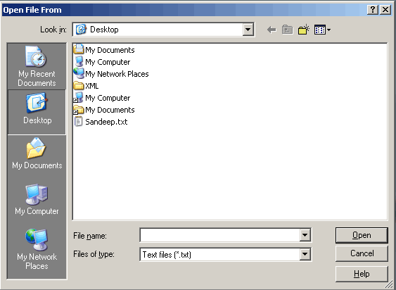
OpenFileDialog Box
Open File Dialog's are supported by the OpenFileDialog class .
They allow us to select a file to be opened.

Slide 10
OpenFileDialog Box
Properties | Mean
AddExtension | Gets/Sets if the dialog box adds extension to file names if the user doesn't supply the extension.
CheckFileEixsts | Checks whether the specified file exists before returning from the dialog.
CheckPathExists | Checks whether the specified path exists before returning from the dialog.
DefaultExt | Allows you to set the default file extension
FileName | Gets/Sets file name selected in the file dialog box
FileNames | Gets the file names of all selected files.
Filter | Gets/Sets the current file name filter string, which sets the choices that appear in the "Files of Type" box.

Slide 11
SaveFileDialog
Save File Dialog's are supported by the SaveFileDialog class and they
allow us to save the file in a specified location.
Properties of the Save File Dialog are the same as that of the Open File Dialog.
Notable property of Save File dialog is the OverwritePromopt property which displays a warning if we choose to save to a name that already exists.

Slide 12
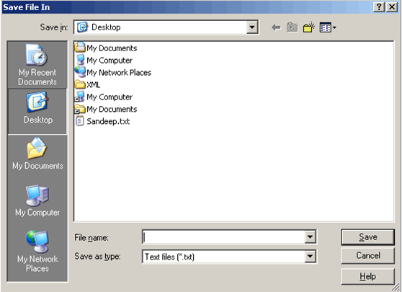
SaveFileDialog

Slide 13
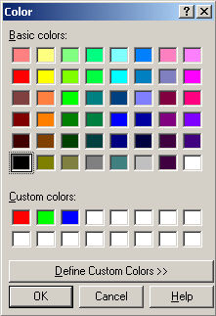
ColorDialog
Color Dialog's are supported by the ColorDialog Class and they allow us to select a color. The image below displays a color dialog.

Slide 14
ColorDialog box properties
Property | Meaning
AllowFullOpen: | Gets/Sets whether the user can use the dialog box to define custom colors.
AnyColor: | Gets/Sets whether thedialog box displays all the available colors in the set of basic colors.
Color: | Gets/Sets the color selected by the user.
CustomColors: | Gets/Sets the set of custom colors shown in the dialog box.
ShowHelp: | Gets/Sets whether the dialog box displays a help button.
SolidColorOnly: | Gets/Sets whether the dialog box will restrict users to selecting solid colors only.

Slide 15
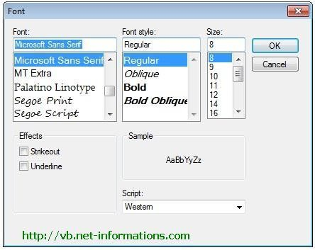
FontDialog Box
The Font dialog box lets the user choose attributes for a logical font,
font family, font style, point size, effects , and a script .

Slide 16
FontDialog Box
Properties | Meaning
AllowVerticalFonts: | Gets/Sets whether the dialog box displays both vertical and horizontal fonts or only horizontal fonts.
Color: | Gets/Sets selected font color.
Font: | Gets/Sets the selected font.
MaxSize: | Gets/Sets the maximum point size the user can select.
MinSize: | Gets/Sets the mainimum point size the user can select.
ShowColors: | Gets/Sets whether the dialog box displays the color choice.
ShowEffects | Gets/Sets whether the dialog box contains controls that allow the user to specify to specify strikethrough, underline and text color options.
ShowHelp: | Gets/Sets whether the dialog box displays a help button.

Slide 17
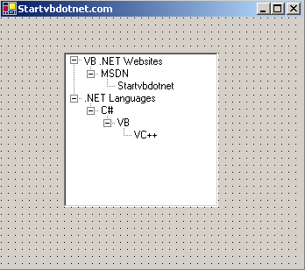
TreeView
The tree view control is used to display a hierarchy of nodes (both parent, child).
You can expand and collapse these nodes by clicking them.

Slide 18
Properties of TreeView
Property | Means
BorderStyle | Gets/sets the tree view's border style.
CheckBoxes | Gets/sets whether checkboxes should be displayed next to tree nodes.
Nodes | Gets the collection of tree nodes.
SelectedNode | Gets/sets the node that is selected.
TopNode | Gets the first visible tree node.
Sorted | Gets/sets if the tree nodes should be sorted.
ShowPlusMinus | Gets/sets whether plus-sign (+) and minus-sign (-) buttons are shown next to tree nodes with child tree nodes.
LastNode: | Gets the last child node
NextNode: | Gets the next sibling node

Slide 19
Methods of TreeView
Method | Means
BeginUpdate | Disables redrawing of the tree view.
CollapseAll | Collapses all nodes.
EndUpdate | Enables redrawing of the tree view.
ExpandAll | Expands all the nodes.
GetNodeAt | Gets the node that is at the given location.
GetNodeCount | Gets the number of nodes.

Slide 20
Events of TreeView
Event | Means
AfterCheck | Occurs when a node checkbox is checked.
AfterCollapse | Occurs when a tree node is collapsed.
AfterExpand | Occurs when a tree node is expanded.
AfterLabelEdit | Occurs when a tree node label text is edited.
AfterSelect | Occurs when a tree node is selected.
BeforeCheck | Occurs before a node checkbox is checked.
BeforeCollapse | Occurs before a node is collapsed.
BeforeExpand | Occurs before a node is expanded.
BeforeLabelEdit | Occurs before a node label text is edited.
BeforeSelect | Occurs before a node is selected.
ItemDrag | Occurs when an item is dragged into the tree view.

Slide 21
Adding node at runtime
How to add a Root Node
TreeView1.Nodes.Add(“Node Name”) TreeView1.Nodes.Add(txtNode.Text) TreeView1.Nodes.Add(InputBox("ENTER NODE NAME"))
How to add a Child node to a selected node TreeView1.SelectedNode.Nodes.Add(“Node Name") TreeView1. SelectedNode.Nodes.Add(txtNode.Text)
TreeView1.SelectedNode.Nodes.Add(“InputBox("ENTER NODE NAME"))")
21

Slide 22
ListView control:
The column collection,
ListView Items and sub items
Items collection
Sub items collection
Sorting in ListView
Processing selected Items
21

Slide 23
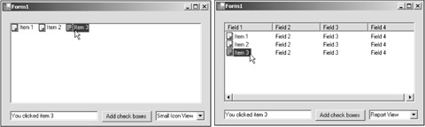
ListView
If tree views are all about displaying node hierarchies, like the folder hierarchy on a disk,
list views are all about displaying lists of items.
21

Slide 24
List views can display their items in four view modes
View.LargeIcon
The large icon mode displays large icons (large icons are 32×32 pixels) next to the item text.
View.SmallIcon
The small icon mode is the same except that it displays items using small icons (small icons are 16×16 pixels).
View.List
The list mode displays small icons, always in one column
View.Details
The report mode (also called the details mode) displays items in multiple columns
21

Slide 25
Property
ListItems :which contains the items displayed by the control.
SelectedItems : contains a collection of the items currently selected in the control.
MultiSelect : The user can select multiple items if the
MultiSelect property is set to True.
CheckBoxes :list views can display checkboxes next to the items, if the CheckBoxes property is set to True.
Sorting: Sort Item in listbox
21

Slide 26
Property
Activation property sets what action the user must take to activate an item in the list:
OneClick requires a single click to activate the item.
TwoClick requires the user to double-click (a single click changes the color of the item text).
Standard requires the user to double-click to activate an item (but in this case, the item does not change appearance).
21

Slide 27
Methods of Listview
Method | Means
ArrangeIcons | Arranges the displayed items in Large Icon or Small Icon view.
BeginUpdate | Stops the list view from redrawing.
Clear | Removes all items from the list view.
EndUpdate | Allows redrawing of the list view.
EnsureVisible | Makes sure that an item is visible.
GetItemAt | Gets the item corresponding to the given X,Y coordinate.
21

Slide 28
Events
Events | Means
AfterLabelEdit | Occurs when a label has been edited.
BeforeLabelEdit | Occurs before a label is changed.
ColumnClick | Occurs when a column is clicked.
ItemActivate | Occurs when an item is activated.
ItemCheck | Occurs when an item is checked.
SelectedIndexChanged | Occurs when the selected index changes.
21

Slide 29
ListView Item Property
The items in a list view are objects of the ListViewItem class, and the collection of those items is stored in the list view's Items property.
Property | Means
Bounds | Gets the bounding rectangle of an item, including its subitems.
Checked | True if the item is checked, False otherwise.
Index | Gets the index in the list view of the item.
ListView | Gets the list view that contains this item.
Selected | Gets/sets if the item is selected.
SubItems | Gets a collection of the subitems of this item.
Text | Gets the text for this item.
21

Slide 30
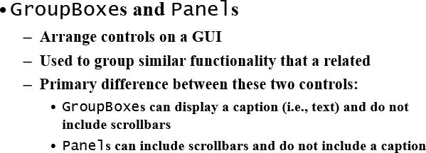
Panel Control & GroupBox
21

Slide 31
GroupBox | properties | Description
Controls | The set of controls that the GroupBox
 | contains.
Text | Specifies the caption text displayed at the top
 | of the GroupBox.
Panel properties | Description
AutoScroll | Indicates whether scrollbars appear when the Panel is too
 | small to display all of its controls. The default value is
 | false.
BorderStyle | Sets the border of the Panel. The default value is None;
 | other options are Fixed3D and FixedSingle.
Controls | The set of controls that the Panel contains.
21

Slide 32
ToolTips
Helpful text that appears when the mouse hovers over an item
ToolTip properties and events
Description
Common Properties
AutoPopDelay
The amount of time (in milliseconds) that the tool tip appears while the mouse is over a control.
The amount of time (in milliseconds) that a mouse must hover over a control before a tool tip appears.
The amount of time (in milliseconds) between which two different tool tips appear (when the mouse is moved from one control to another).
InitialDelay
ReshowDelay
Common Event
Draw
Raised when the tool tip is displayed. This event allows programmers to modify the appearance of the tool tip.
21

Slide 33
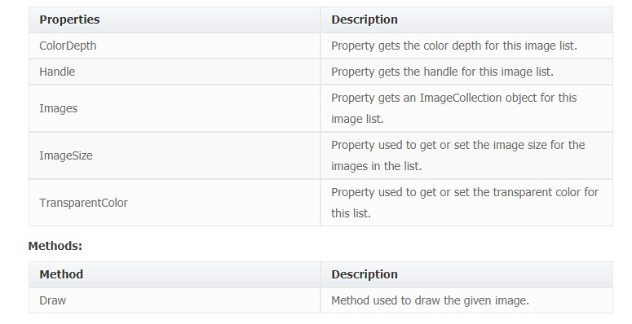
ImageList Control
An ImageList is a supporting control that is typically used by other controls, such as a ListView but is exposed as a component to developers. We can use this component in our applications when we are building our own controls such as a photo gallery or an image rotator control.
21

Slide 34
SplitContainer Control
SplitContainer is an advance window's control or it is an extended version of old
splitter control. You can place it at form horizontally or vertically by specifying
Orientation property each represents left/top and right/bottom panels respectively.
Properties:
Dock
Allows you to attach Splitcontainer's border to its container. When you drop the
splitcontainer on a form a Default value of Dock property is 'FILL' that means
splitcontainer gets the whole area of form. In this example, I have set it to 'None' for the sack of demonstrating splitcontainer features.
Panel1Collapsed / Panel2Collapsed
Used to set or get whether the panel1 or Panel2 is collapsed or expanded. If you
assign true to Panel1Collapsed then left or top panel will be collapsed and if you
assign false to Panel1Collapsed then left or top panel will be expanded same
behavior will be occurred with Panel2Collapsed property.
Orientation
Used to set or get the orientation of splitcontainer panel
Splitter Width
Splitter is a horizontal or vertical bar which use to set panel size, default size of
splitter is 4 pixel but you can set or get the splitter width value programmatically
by manipulating splitterwidth property.
21

Slide 35
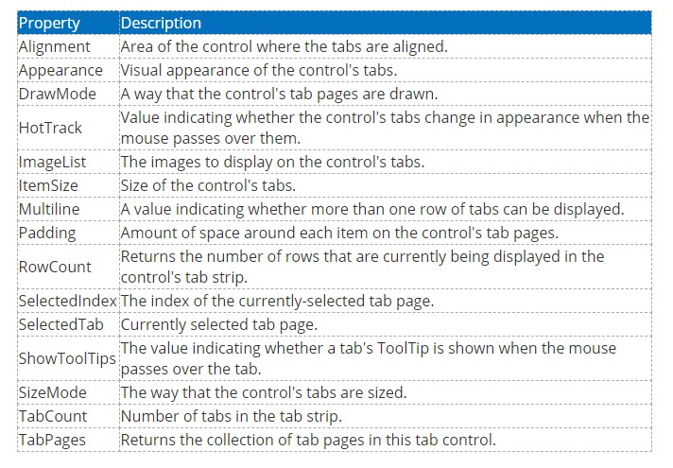
Tab Control
A TabControl is a collection of tab pages and a tab page is the actual control that hosts other child controls. TabPage class represents a tab page.
Properties:
21

Slide 36
MenuStrip Control
The MenuStrip control represents the container for the menu structure.
The MenuStrip control works as the top-level container for the menu structure. The ToolStripMenuItem class and the ToolStripDropDownMenu class provide the functionalities to create menu items, sub menus and drop-down menus.
Properties:
Sr.No. | Property & Description
1 | CanOverflow Gets or sets a value indicating whether the MenuStrip supports overflow functionality.
2 | GripStyle Gets or sets the visibility of the grip used to reposition the control.
3 | MdiWindowListItem Gets or sets the ToolStripMenuItem that is used to display a list of Multiple-document interface (MDI) child forms.
4 | ShowItemToolTips Gets or sets a value indicating whether ToolTips are shown for the MenuStrip.
5 | Stretch Gets or sets a value indicating whether the MenuStrip stretches from end to end in its container. 36

